Slide 1


Spotify Algorithms
& Machine Learning
+
Gareth Hughes

Slide 2

History
Founded in 2008
Database of:
35 million songs
180 million users.
Monthly subscription (9.99 EUR)
Easy to upload to (Distrokid)

Slide 3
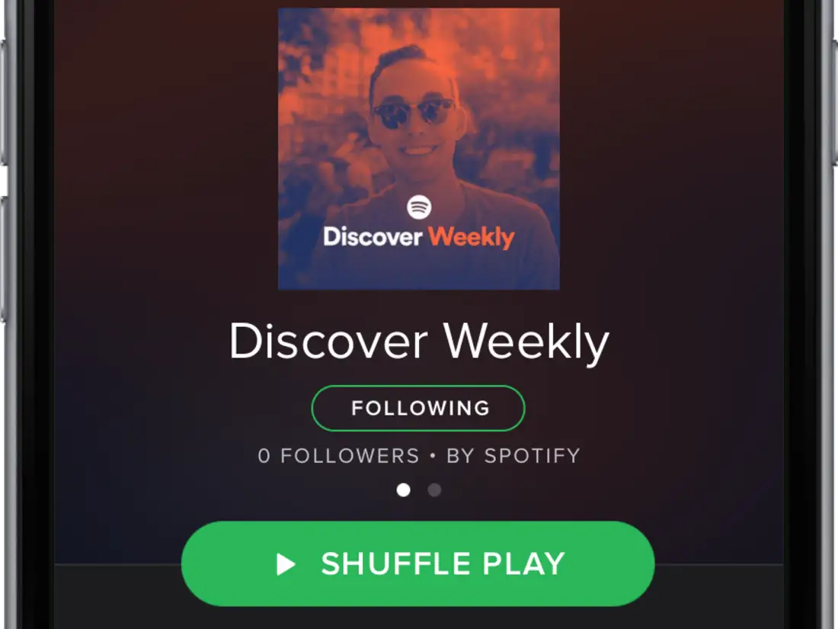
Discover Weekly
30 song weekly playlist “unique” to each individual user.
Generated based on three algorithms.
Collaborative Filtering

Slide 4
Discover Weekly
30 song weekly playlist “unique” to each individual user.
Generated based on three algorithms.
Collaborative Filtering
Natural Language Processing

Slide 5
Discover Weekly
30 song weekly playlist “unique” to each individual user.
Generated based on three algorithms.
Collaborative Filtering
Natural Language Processing
Audio Models

Slide 6

Collaborative Filtering
Compares similarities user listening habits.
Eg: if you and your friends like Pink Floyd, and your friends like Radiohead, we can assume you might like them too.
Also utilised by Netflix!

Slide 7
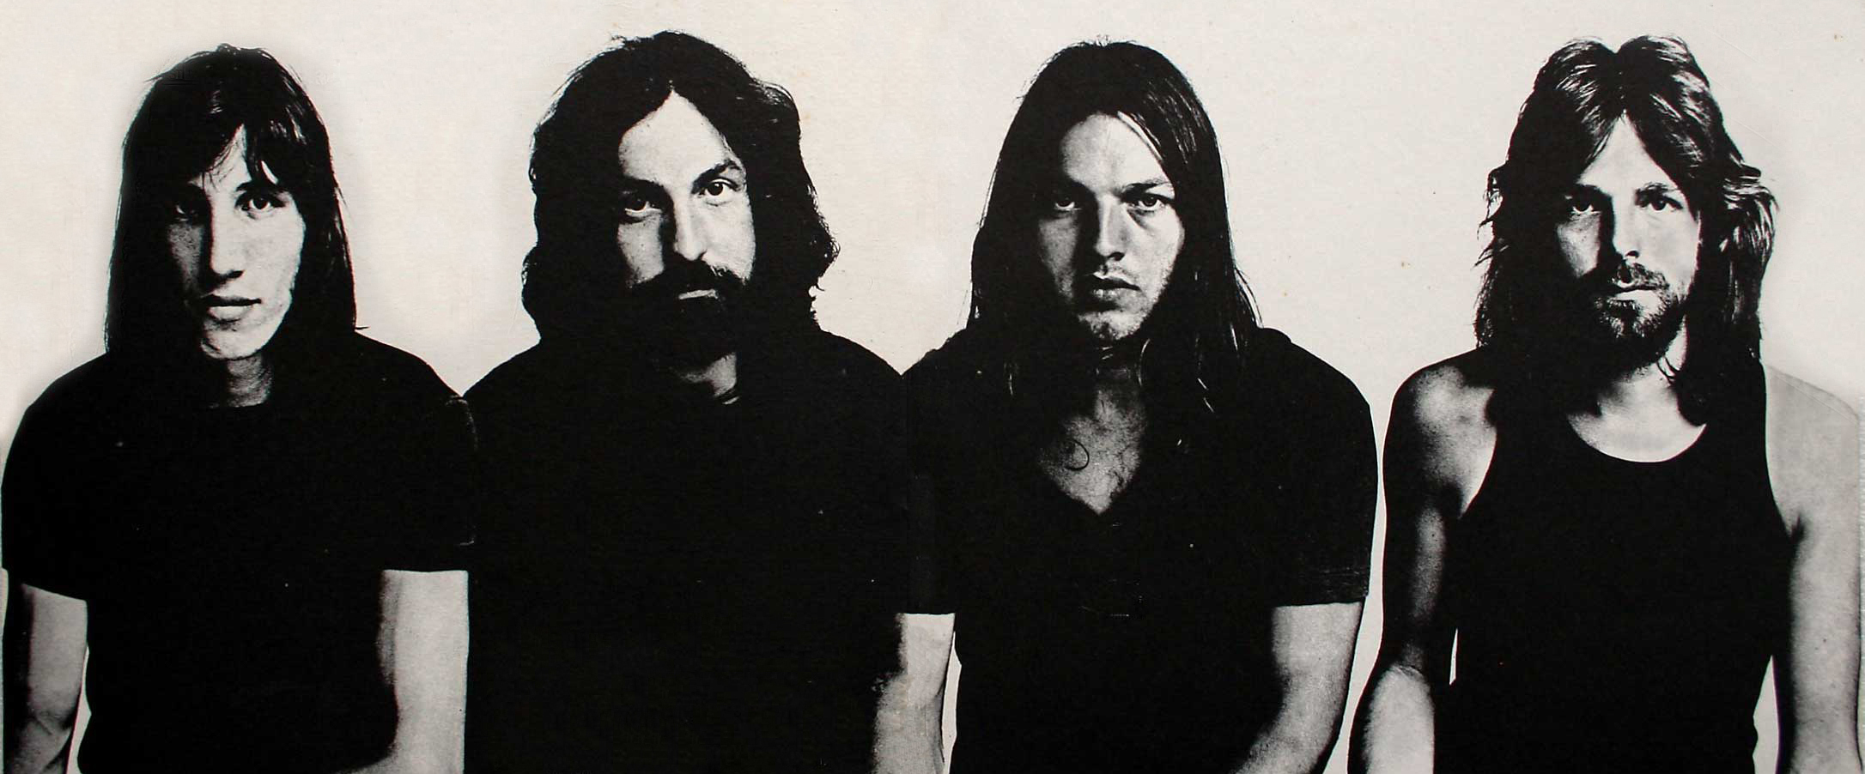
Collaborative Filtering
Compares similarities user listening habits.
Eg: if you and your friends like Pink Floyd, and your friends like Radiohead, we can assume you might like them too.
Also utilised by Netflix!

Slide 8
Collaborative Filtering
Compares similarities user listening habits.
Eg: if you and your friends like Pink Floyd, and your friends like Radiohead, we can assume you might like them too.
Also utilised by Netflix!

Slide 9
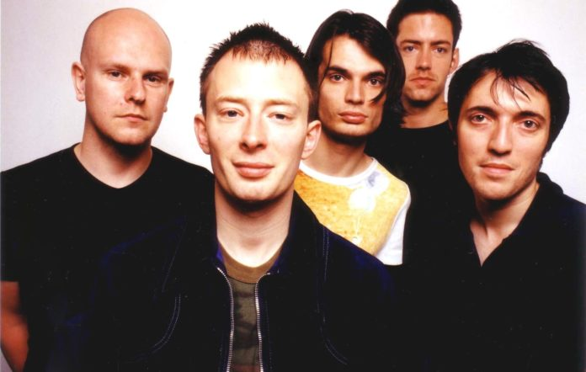
Collaborative Filtering
Compares similarities user listening habits.
Eg: if you and your friends like Pink Floyd, and your friends like Radiohead, we can assume you might like them too.
Also utilised by Netflix!

Slide 10

Natural Language Processing
Spotify actively analysis's what’s being said about each artist.
Blog posts / articles.
Compares descriptive data.

Slide 11
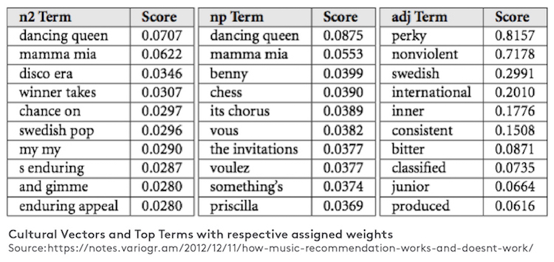
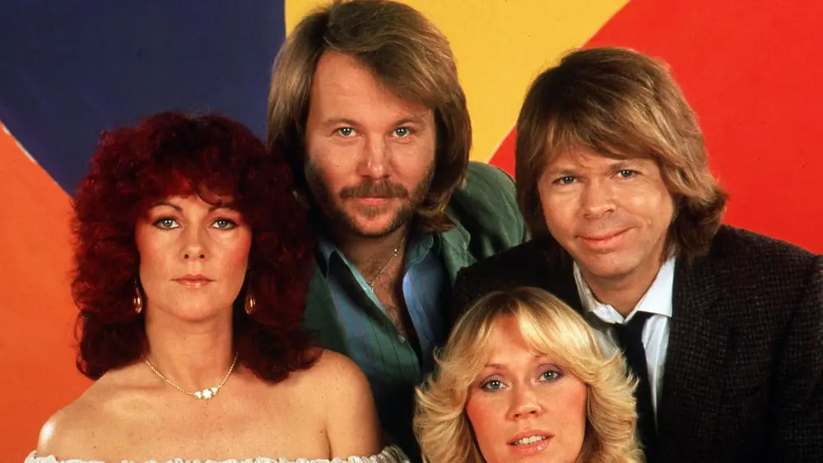
Natural Language Processing
Spotify actively analysis's what’s being said about each artist.
Blog posts / articles.
Compares descriptive data.

Slide 12
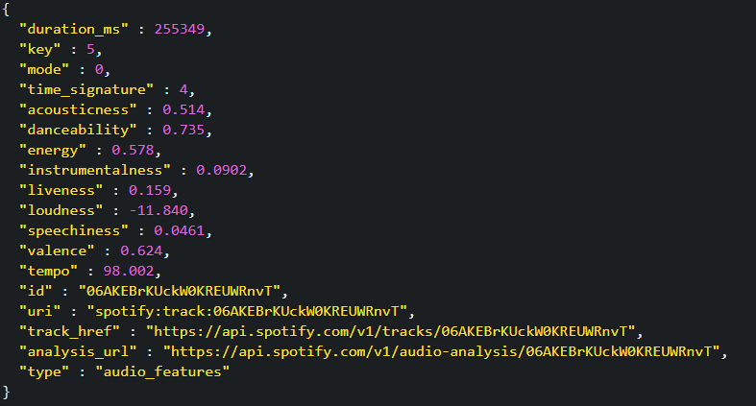
Audio Models
Acousticness

Slide 13
Audio Models
Acousticness
Tempo

Slide 14
Audio Models
Acousticness
Tempo
Energy
And many more variables...

Slide 15
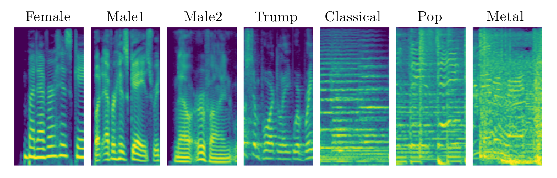
Audio Models
Spectrograph

Slide 16
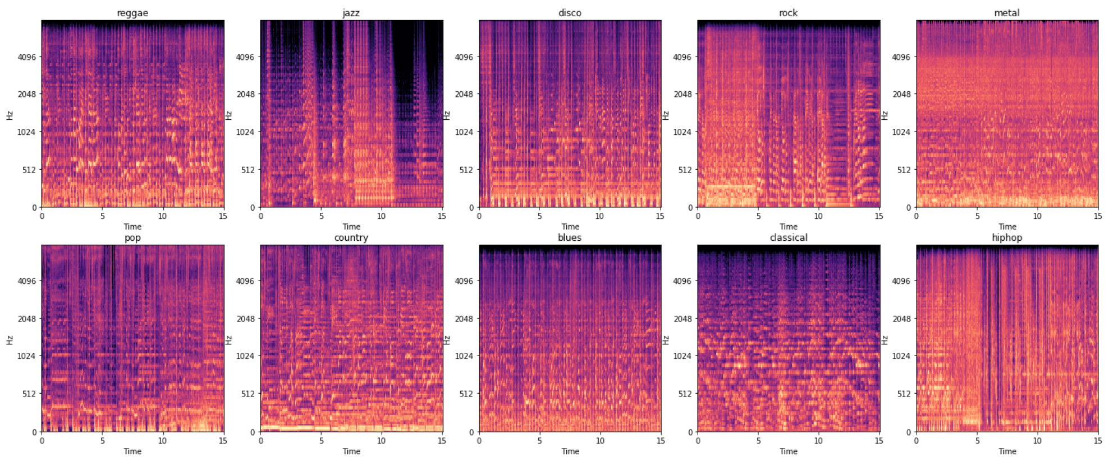
Audio Models
https://towardsdatascience.com/musical-genre-classification-with-convolutional-neural-networks-ff04f9601a74

Slide 17
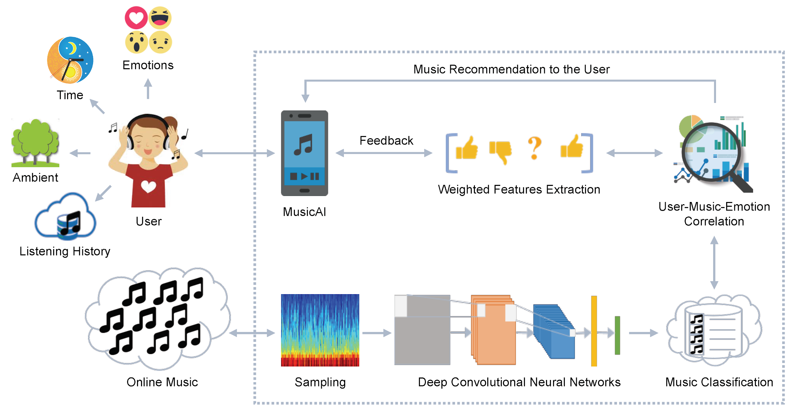
Audio Models

Slide 18
Conclusions
Extensive, machine learning driven system
Arguably one of the best music recommender systems available to consumers
Currently it mostly depends on Collaborative Filtering,
More emphasis on NLP and Audio Models in future.

